Slide 1
PHISHING url detector
Guided by:
MR.S.S.YUVARAJ MCA., M.Phil., M.E,. Ph.D
ASSISTANT PROFESSOR
DEPT OF COMPUTER SCIENCE
By:
Narendran G R
20BCM028
3rd B.Sc. Computer Science A
PSG College of Arts & Science

Slide 2
ABSTRACT
This project aims to detect phishing websites using machine learning approaches and implement the system with high efficiency, accuracy, and cost-effectiveness.
We using Gradient Boosting Classifier for best accuracy score, that gives accuracy of 97.4%
Additionally, this project addresses the exploitation of Quick Response (QR) codes by phishers to launch phishing attacks and proposes a solution to identify phishing or legitimate links in suspicious QR codes.

Slide 3
SYSTEM REQUIREMENTS
HARDWARE REQUIREMENTS:
Processor | Intel Pentium Dual Core and Higher
Hard disk | 10 GB
RAM | 4GB minimum
SOFTWARE REQUIREMENTS:
Front end | HTML, CSS, JavaScript, Flask
Language | Python and Jupyter
Backend | Apache
Operating System | Windows 8 or above

Slide 4
MODULES
Input URL
Upload QR
Detection of URL

Slide 5
MODULE DESCRIPTION
Input URL
The URL that you suspect, whether it is legitimate or phishing is given to the model. The sentence that contains the URL is given, so that the Algorithm separates the URL and checks whether it is legitimate or phishing.
Upload QR
The QR code is decoded by uploading it and the decoded text is parsed to the model and the model checks for malicious links and predicts.
Detection of URL
On the successful detection of the URL, the predictions and accuracy of the prediction is shown as output.

Slide 6
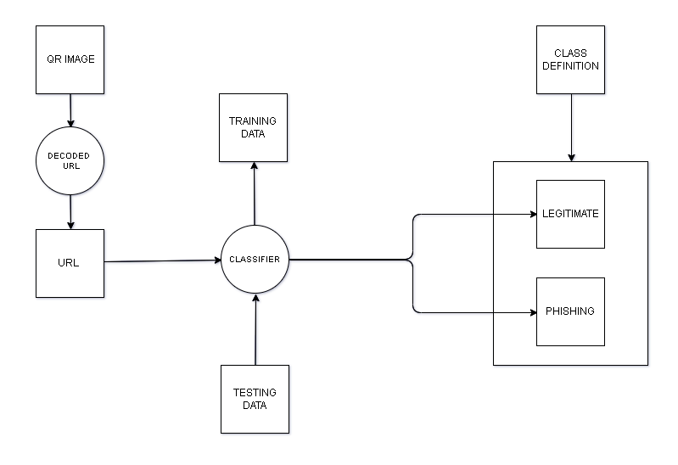
SYSTEM FLOW DIAGRAM

Slide 7
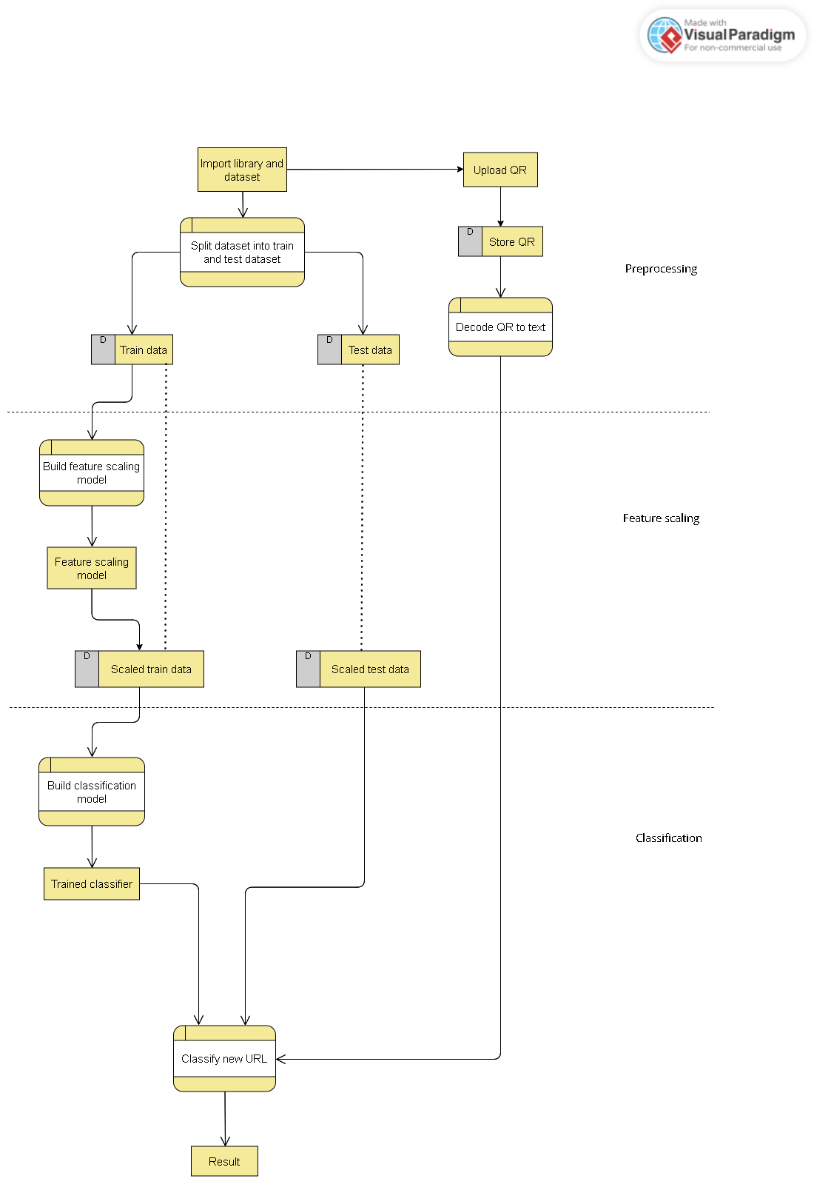
DATA FLOW DIAGRAM

Slide 8
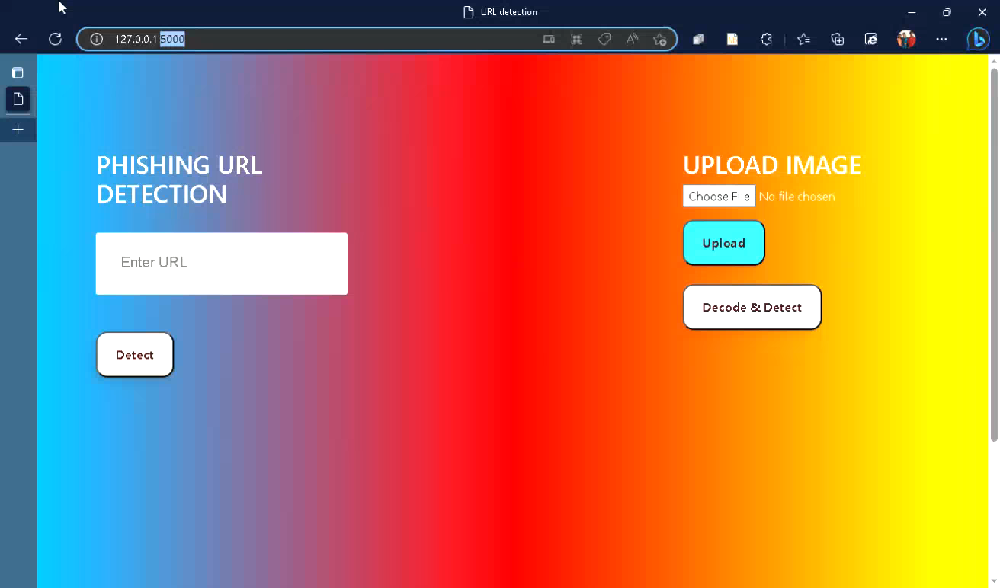

Slide 9
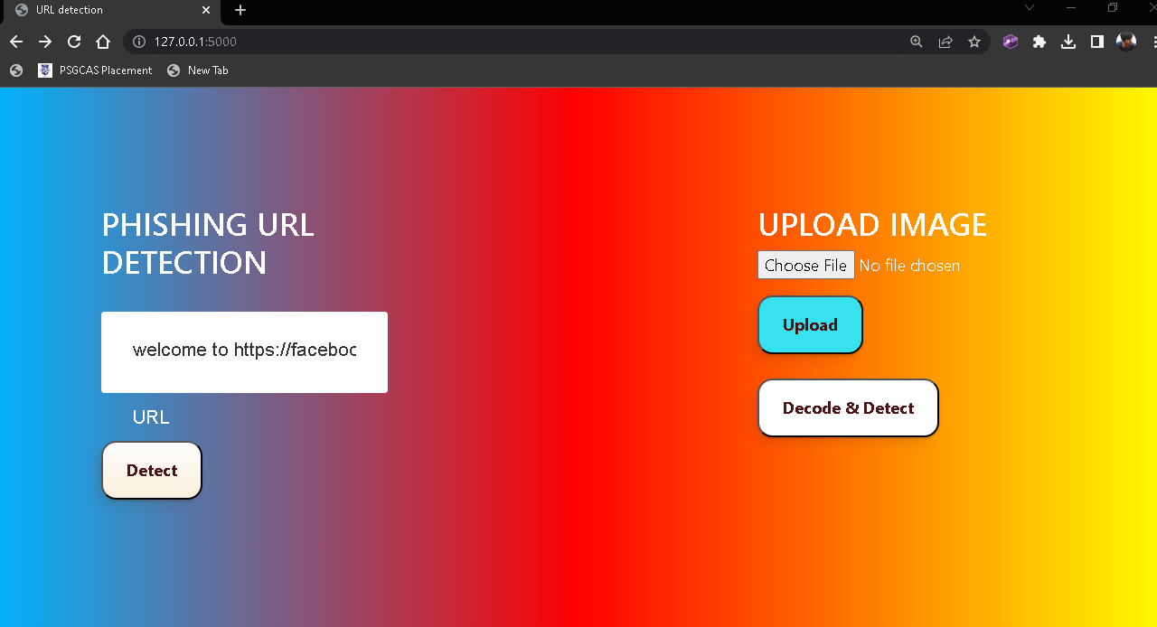
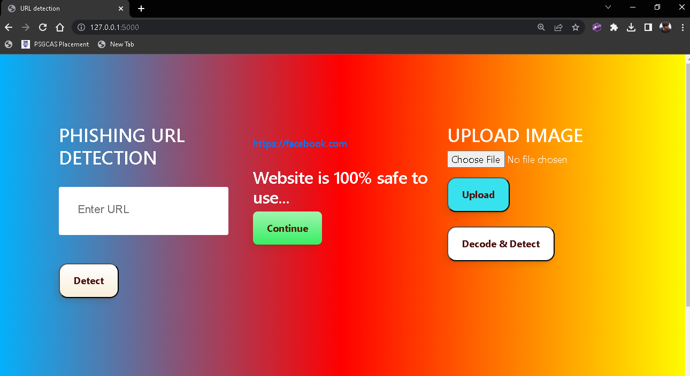
Input
Output

Slide 10
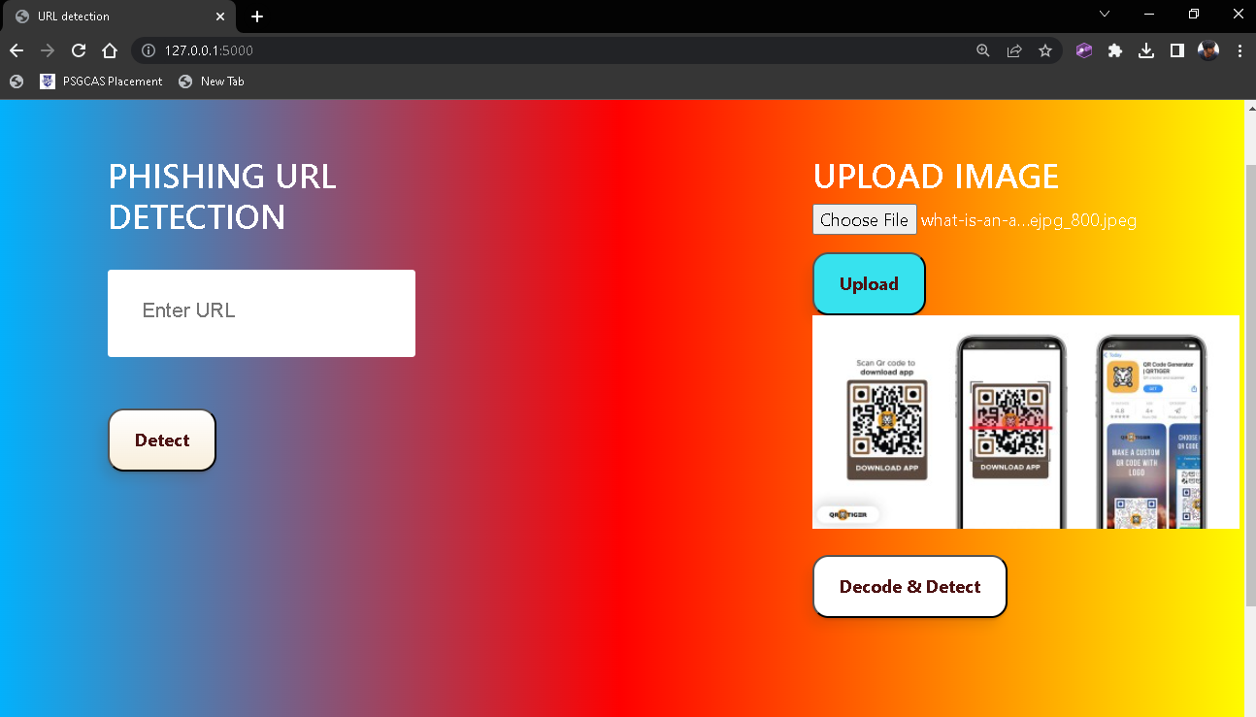
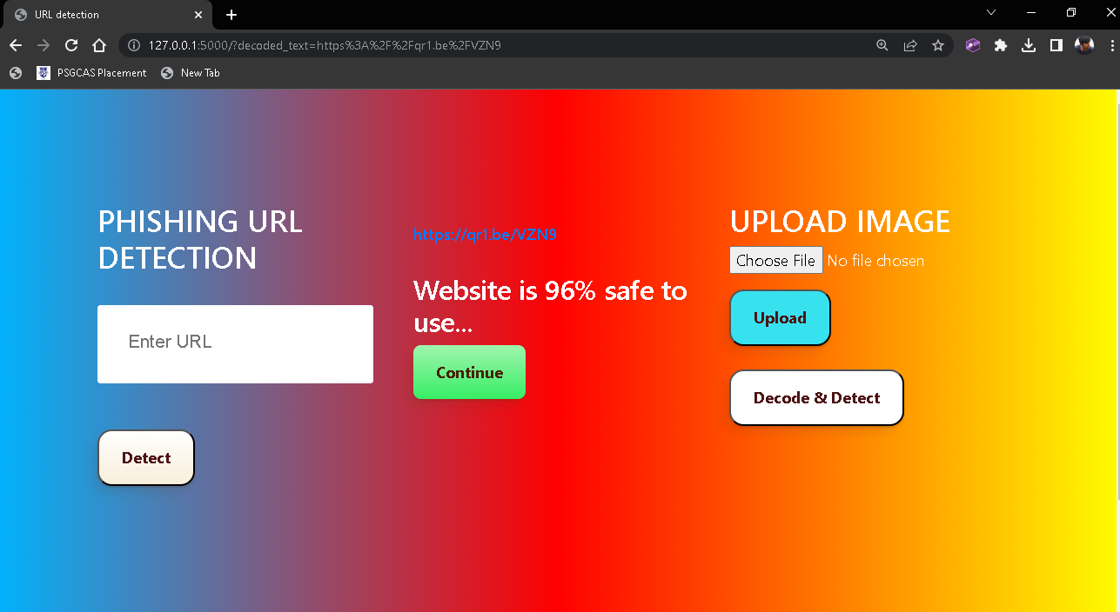
Input
Output

Slide 11
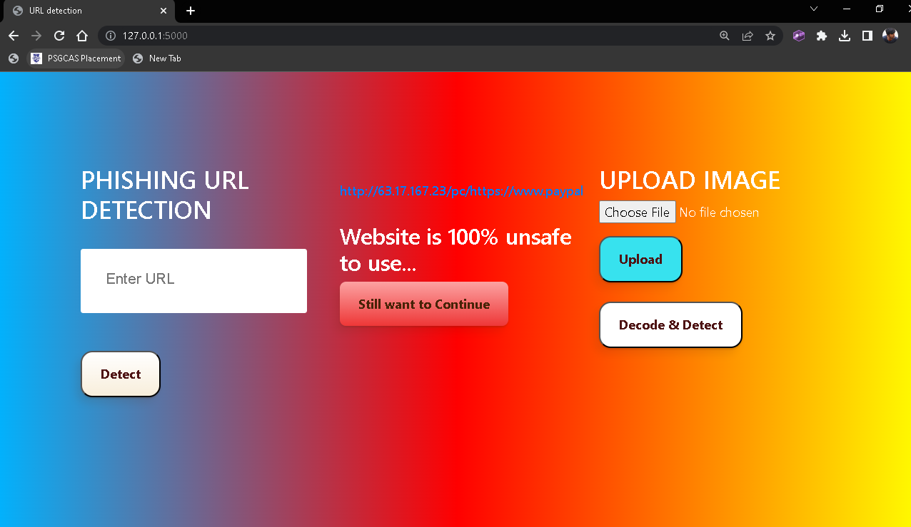
Phishing

Slide 12
THANK YOU

